Slide 1

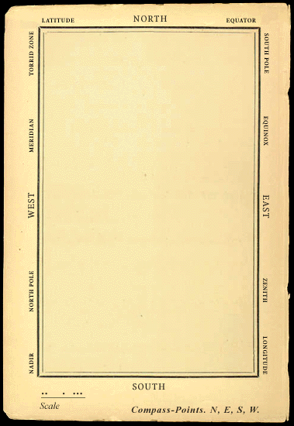
Common sense web ‘a map they could all understand’
He had bought a large map representing the sea, Without the least vestige of land: And the crew were much pleased when they found it to be A map they could all understand. ‘What’s the good of Mercator’s North Poles and Equators, Tropics, Zones, and Meridian Lines?’ So the Bellman would cry: and the crew would reply, ‘They are merely conventional signs!’ ‘Other maps are such shapes, with their islands and capes! But we’ve got our brave Captain to thank’ (So the crew would protest) ‘that he’s bought us the best— A perfect and absolute blank!’ [Lewis Carroll, ‘The hunting of the Snark’]

Slide 2
agenda
9:30 – 10:00 Kennismaking & Doel
10:00 – 10:30 Common Sense Overview
10:30 – 11:15 Projects & Layers
11:15 – 12:00 Getting Started
13:00 - 14:00 Diving Deeper
14:00 – Hands on, Community, etc.

Slide 3
Introduction
Erik Vullings
Arnoud de Jong

Slide 4
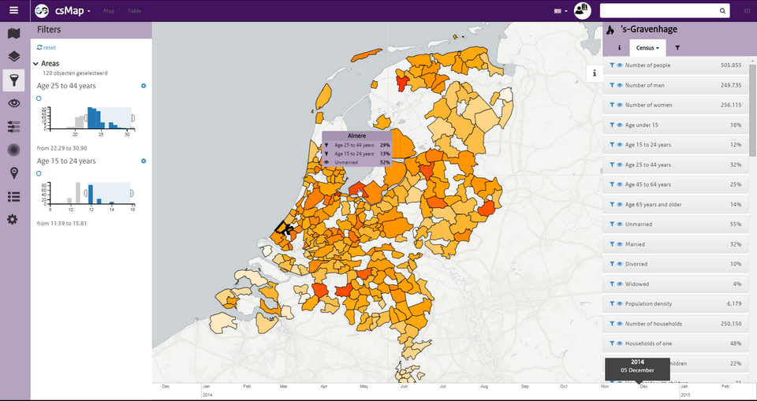
introduction
Common Sense Web is a user friendly web-based GIS application, which packages a lot of functionality
It arose out of the need to offer TNO models and visualisations to users in many projects
Technically, it is split between common libraries and frontend GUI, so its easy to roll your own
Is open source. MIT license, so open for commercial use as well. You can fork us on GitHub.
Other users: NLR, eScienceCentre. Evaluation: Deltares, Fraunhofer

Slide 5
started in September 2014, already used IN
Healthcare
Zorg|op|de|kaart
AHTI Amsterdam
Defence, Safety and Security
Military Space (+NLR)
TO2 Crisis Mgmt (+NLR, Deltares, RIKILT)
TO2 Critical Infrastructure Protection
Real-time Intelligence centre
Brandweer Nederland
EU
ECODISTR-ICT
CIPRNet (Fraunhofer)
Dashboards
UrbanStrategy
CityDashboard Rotterdam
CityDashboard Eindhoven
Verkeerdemo
Afval Almere
Buiksloterham
Cycle Dashboard
Fit2Perform
Connekt Mobiliteit
Archeology
POVtree (eScienceCentre)

Slide 6
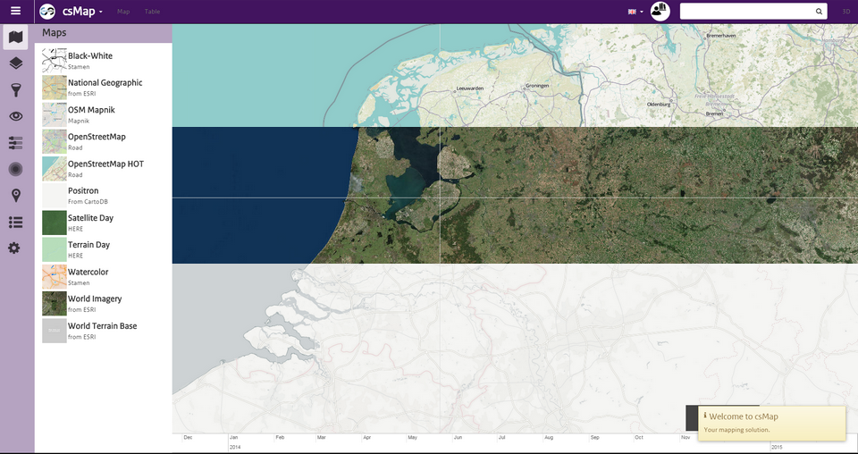
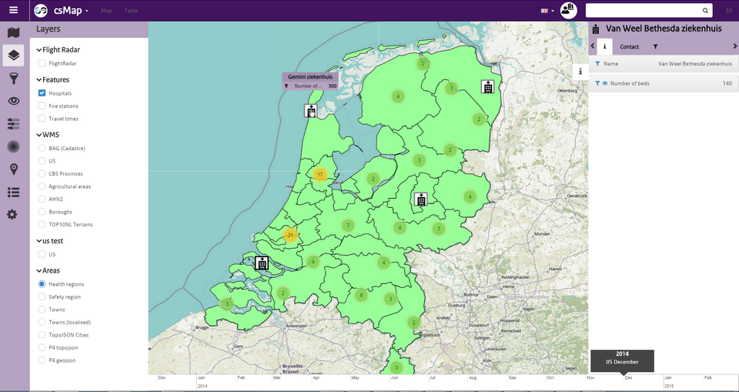
COMMON SENSE OVERVIEW
Base Layers
Select different base layers
You can add your own (e.g. mbtiles)
E.g. OpenStreetMap HOT, Satellite, or Positron
Map Layers
E.g. geojson, topojson, grid raster files
Also WMS, hierarchical, heatmap or MCA
Icons are based on feature or property

Slide 7
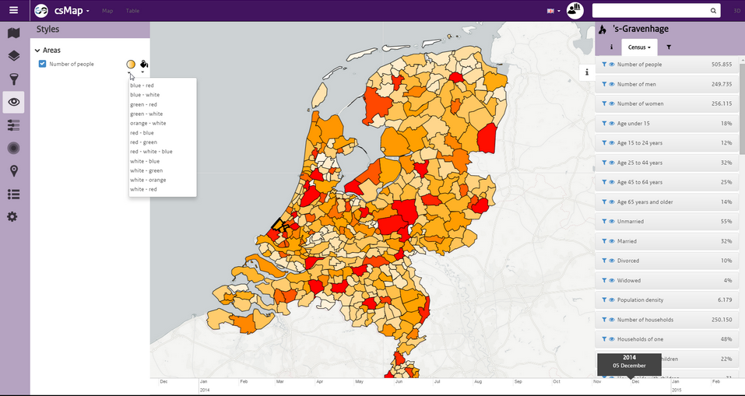
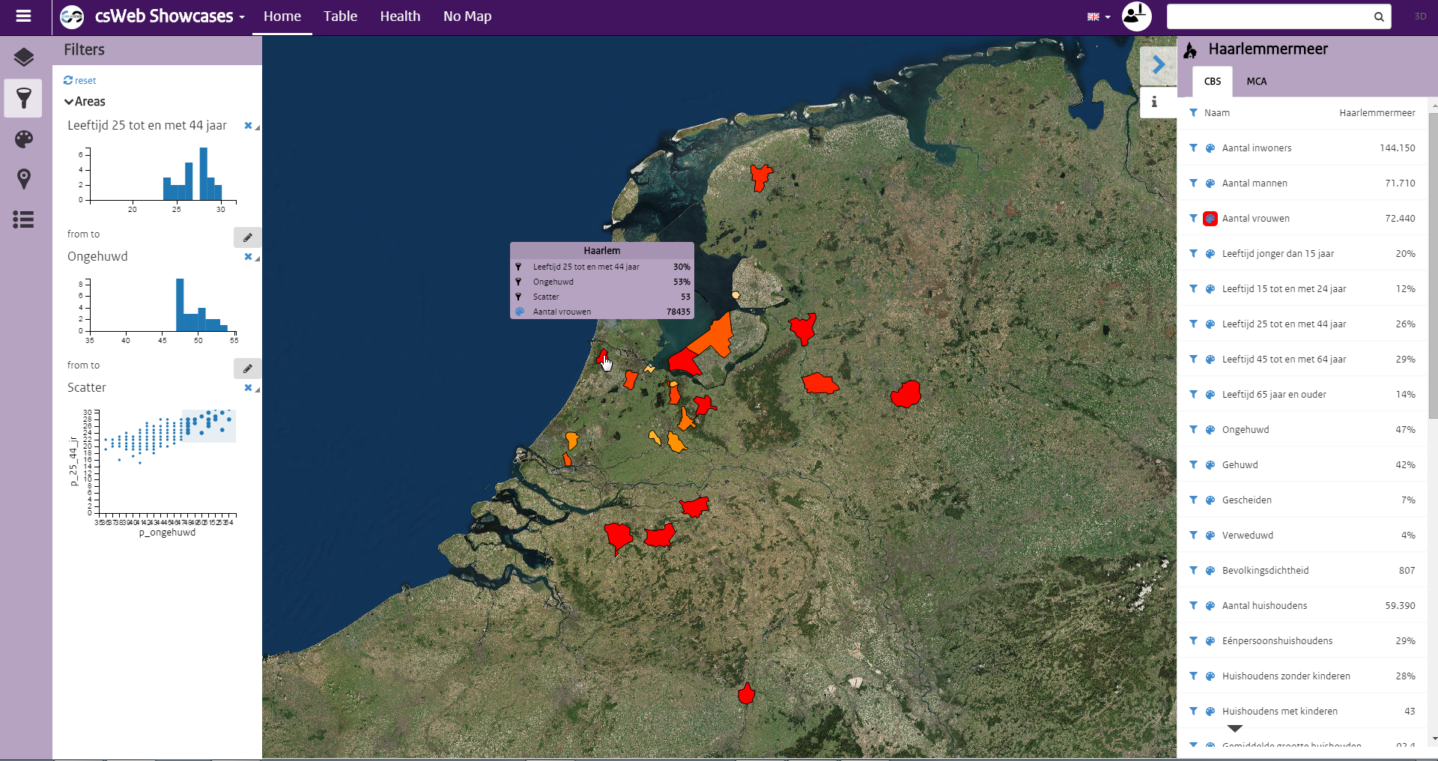
COMMON SENSE OVERVIEW
Styles
Highlight an area or feature using a predefined color scheme
E.g. the number of people in Dutch towns
Filters
Specify which features are shown
E.g. a high % of unmarried people in the age category 25-44y, styled by the % of women

Slide 8
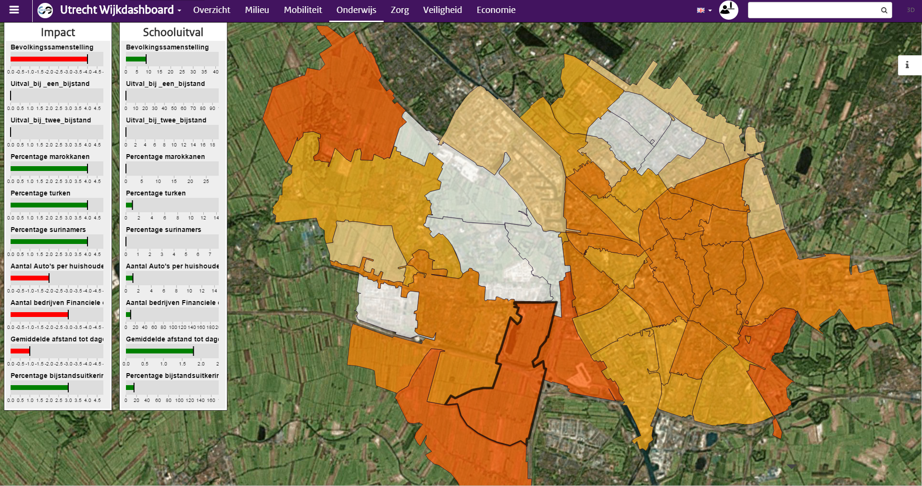
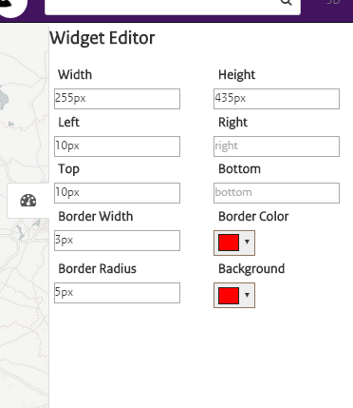
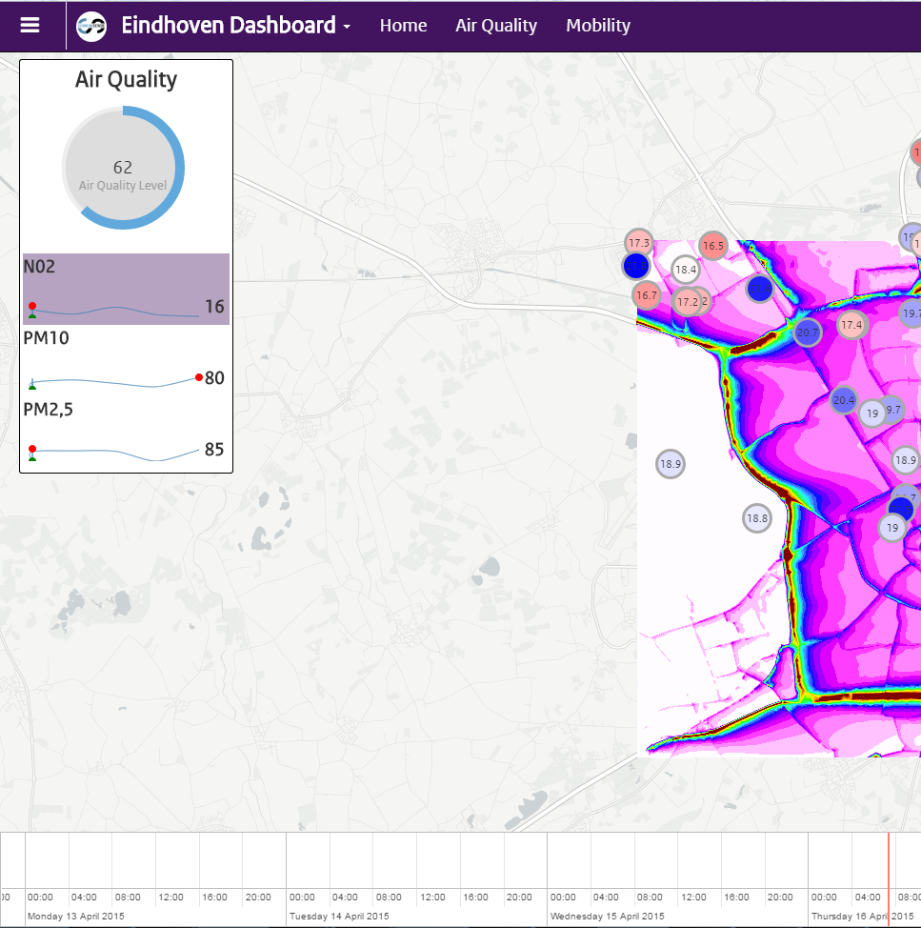
COMMON SENSE OVERVIEW
Dashboards (tabs)
Theme/Role specific dashboards/portals
Customizable widgets
Configure viewbound, layers, timeline, etc.
Widgets
Reusable components
E.g. for HTML, Markdown, charts, gauges

Slide 9
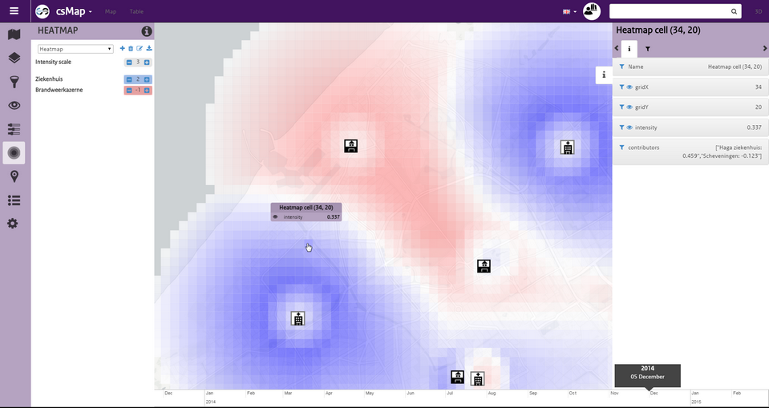
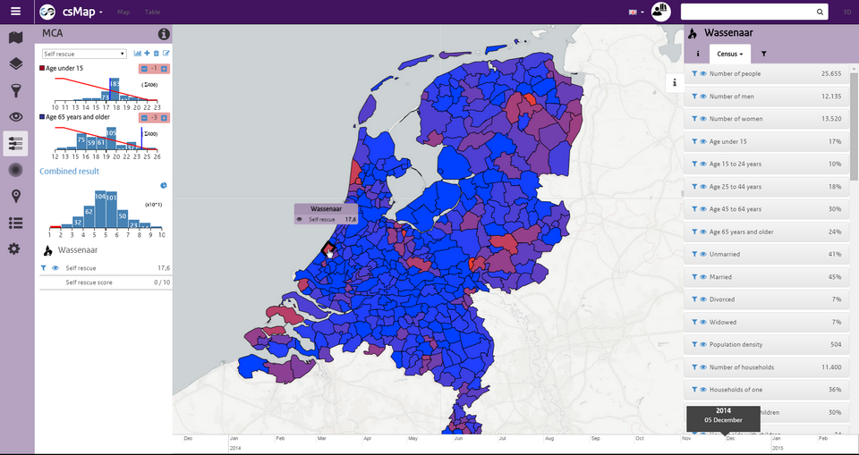
COMMON SENSE OVERVIEW
Heatmaps
Select features (properties) of interest
Set ideality parameters
Weight features
MCA (Multi-Criteria Analysis)
Select properties of interest
Weight them
Score and rank them

Slide 10
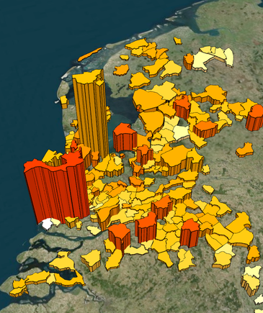
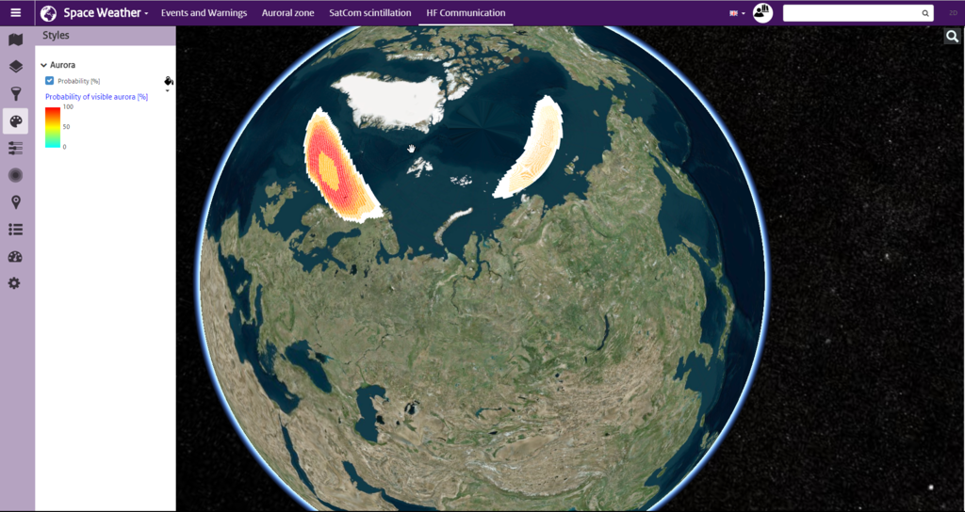
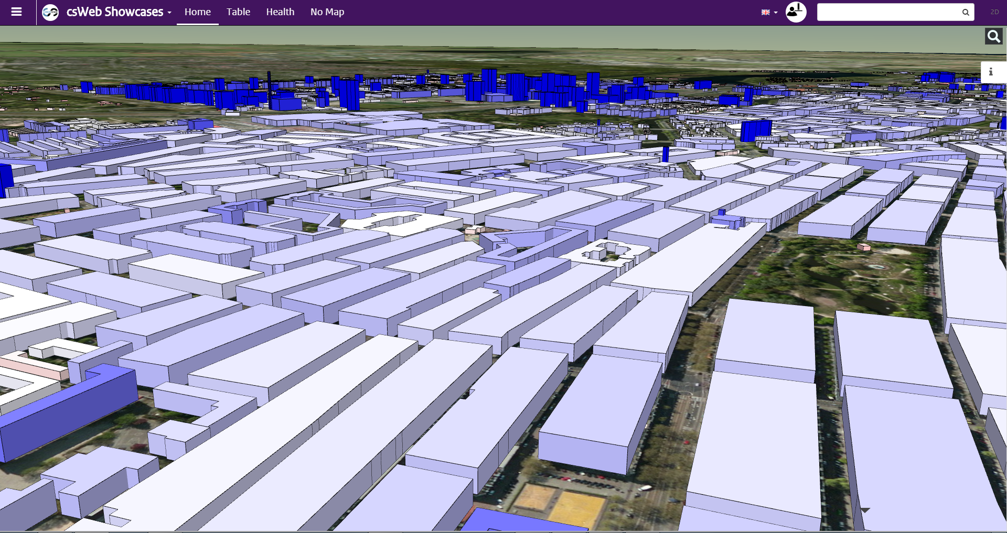
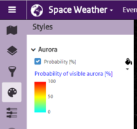
Common Sense overview
Legends
Describe colour range and property
Select by default
3D Rendering
Extends 2d view with 3d models
New styling options

Slide 11
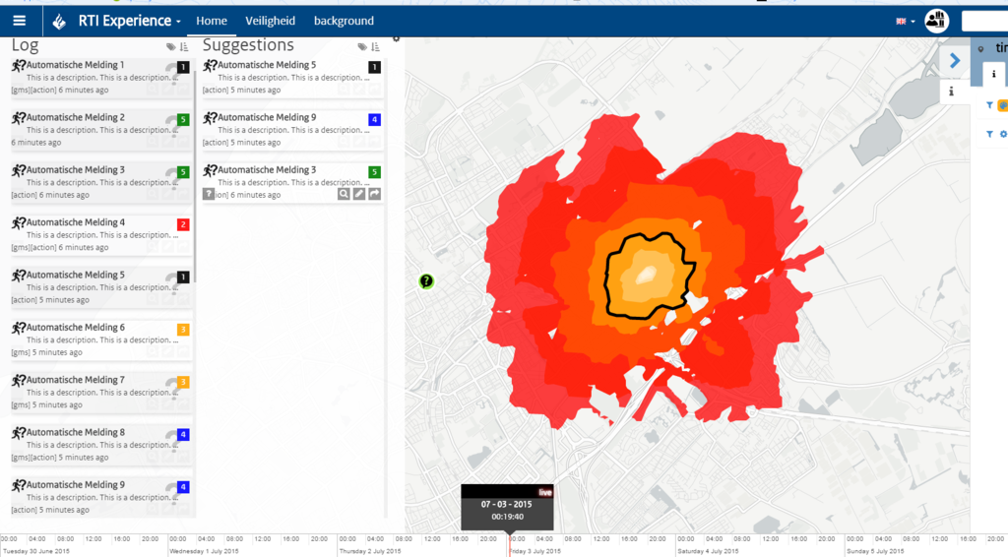
Common Sense overview
Accessibility service (‘where did you go?’)
Select a point on the map and show the accessible area that you can reach walking|driving|etc. after a certain time.
Kanban boards
Show news feeds/tweets/messages in a log
Answer questions
Allocate tasks

Slide 12
COMMON SENSE OVERVIEW
Coupling with Excel
Select your data (properties) and describe them
Describe your layer (title, group)
Push: use existing geometry or lookup address
Other functionality
Localization support (GUI and data)
Time aware
Switching between projects
Expert levels

Slide 13
roadmap
Dashboard Challenge (June 2015)
Create a website for each Dutch city
Arrange open data thematically, e.g. Health, Public Transport, Safety, Energy…
Add (some) TNO model outputs, e.g.
Urban strategy layers (traffic, pollution)
Dashboards and KPIs
Business model:
Upgrade cities who want more
Collaboration and real-time sharing
Share layers dynamically with
Common sense desktop
Other web clients
Add more data sources
Static: e.g. shape, netcdn files
Dynamic: e.g. flight or blue force tracking
Edit layers: add new features, store them
Better support for tablets and smartphones
Add models to layers and features, e.g. perform risk analysis or calculate line-of-sight
Data warehouse: store, publish and transform your data

Slide 14
Demo time
csMap
Wijkdashboard
Dashboard Eindhoven
MilitarySpace

Slide 15
Technology

Slide 16
Solution, Project & layers
Solution (projects.json)
Is mainly used for managing multiple themes, i.e. each main theme in the application can have its own set of maps and layers, so you can easily switch between them
Properties
title (deprecated)
maxBounds (map pan limit) and viewBounds (initial view)
southWest, northEast
baselayers:
title, (subtitle)
url
isDefault
minZoom and maxZoom level
subdomains
attribution
preview (image url)
Projects (1+)
title
url: links to project.json file

Slide 17
Solution, Project & layers
Project (projects.json)
Groups strongly related basemaps, group layers, and layers, as well as feature and property types. Is also used for specifying configuration and user privileges.
Properties
title, description, url and logo (img)
maxBounds and viewBounds
baselayers
connected (bool)
expertMode (1, 2, 3 = beginner… expert)
featureTypes, propertyTypeData (next)
userPrivileges (mca|heatmap expertMode)
timeline
Start, end (±msec since 1/1/1970)
range, zoomLevelName, isLive)
groups (of map layers)
title, description
clustering (bool), clusterLevel
layers
id (title), reference (key)
type (geojson, topojson, wms, dynamicgeojson)
url: links to data source
enabled (bool), opacity (0…100)

Slide 18
Feature Types
Describe the visual representation of a (point or area) feature on the map.
Specified in project.json (so a feature type can be reused across map layers) or geo|topo-json
Can contain propertyTypeData [array] or propertyTypeKeys (references project propertyTypeData)
Is a dictionary [FeatureTypeName]: FeatureType
name
style
fillColor, strokeColor (e.g. #ffffff00 or name)
strokeWidth
innerTextProperty, innerTextSize
drawingMode (point)
rotate, rotateProperty
iconWidth, iconHeight
iconUri
Plain vanilla image url
Or with property reference, e.g. img/EnergyLevel_{energyLevel}.png
sensors & timestamps

Slide 19
Property Types
PropertyTypes describe how a geojson property should be displayed to the user.
label
title, description
type
section
stringFormat
visibleInCallout
isSearchable
minValue, maxValue
defaultValue
options, languages, legend

Slide 20
Localisation
Support for multiple languages is built in:
GUI key-based translation files (English and Dutch)
Data key-based languages (dictionary) objects for (group) layers and property types.
languages
key: language (e.g. ‘en’ or ‘nl’)
title (e.g. of layer), name (e.g. of feature), description, section,
…
"languages": {
"nl": {
"title": "Ziekenhuizen",
"description": "De locaties van de Nederlandse ziekenhuizen."
},
"en": {
"title": "Hospitals",
"description": "These are the locations of the Dutch hospitals."
}
}
…

Slide 21
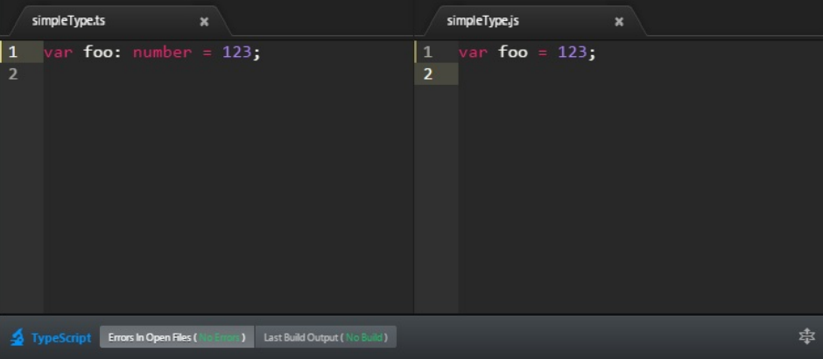
GETTING STARTED
Read the manual
Node.js, a lightweight server
TypeScript (free ebooks [1], [2]), compiles to js
csWEB
NPM & BOWER for managing external dependencies
GULP build tool
Open source IDE: Atom+atom-typescript plugin

Slide 22
DIVING DEEPER
Angular
Modules / Directives
Services
MessageBus
LayerService
LayerSources
Renderers
LayerService
Open solution
Open project
Open Layer
MCA
Filtering
Styling
Layer Sources
GeoJson
TileLayer
Wms
Heatmap
Dynamic Geojson
Map Renderer
Leaflet
Cesium

Slide 23
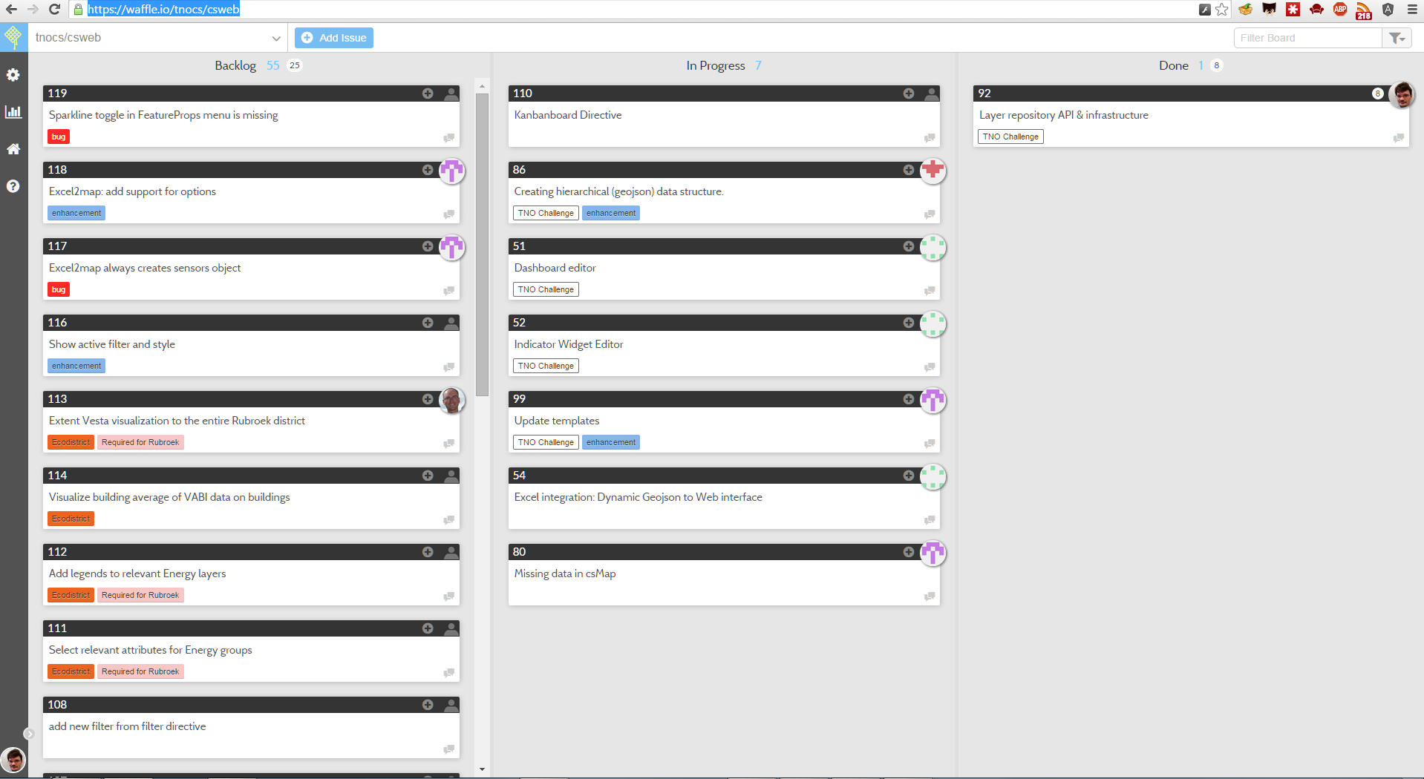
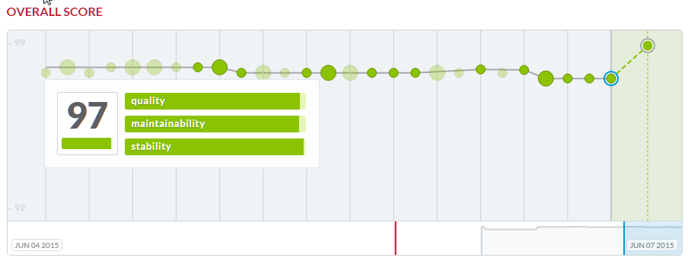
What’s next?
Community
Waffle, our Kanban board
Wiki on Github
Slack for supporting collaboration
TravisCI for Continuous Integration
Karma & Jasmine for Unit testing
Bithound, for code quality review

